Slide 1


Object
Oriented
Programming
MEC Academy

Slide 2
Agenda
What is an algorithm ?
Analysis
Linear search algorithm
Analysis of linear search
Binary search algorithm
Analysis of binary search
Schedule (High Level)
Completed Activities
Dependencies
&
Issues / Risks
Timeline
Action
Items
Change Requests

Slide 3
What is an algorithm ?
Algorithm is a set of instructions to be followed for solving a problem.
It has :
Input.
Output.
Instructions (clear and unambiguous).
Terminates after a finite number of steps.

Slide 4
Algorithm analysis
Counting instruction of the algorithm
Each instruction will take a one unit of time
Example :
Initialize variable integer num1
Initialize variable integer num2
Add those 2 variables
Print the result
1
1
1
1
T(n) = 4

Slide 5
Algorithm analysis
Example :
For ( int i = 0 ; i <= n ; i++ )
Print hello
1
n+1
n
n
T(n) = 3n+2
We can neglect the constant numbers and the multiplication
So answer is n
T(n) = n

Slide 6
Asymptotic analysis
Big Oh worst case O(n)
Omega best case Ω (n)
Theta average case ϴ (n)
https://ideone.com/2MgMGJ
https://ideone.com/tAfCAk

Slide 7
Linear search
The problem is
Given an array of n elements and a target element search in the array on the target element.
The algorithm
Scan the array from left to right searching on the target element.

Slide 8
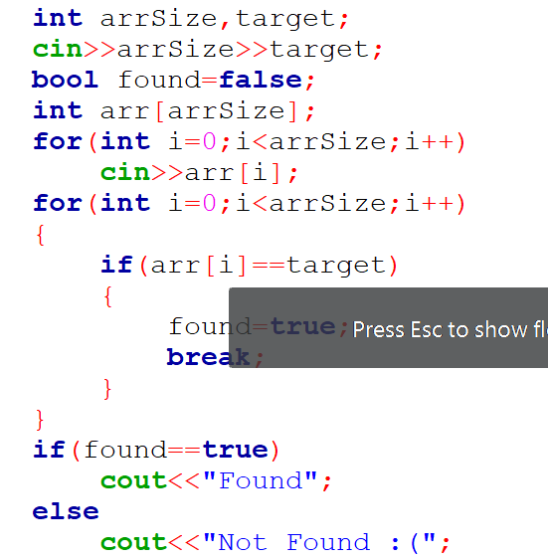
Linear search
Pseudocode :
Input target element
Initialize array
Initialize boolean variable to false
Loop on the array
If the element equal to the search element
break
1
n
1
n
n
1
T(n) = n

Slide 9
Linear search analysis
T(n) = n
The best case is when the first element is the target.
Ω (n) = 1
The worst case is when the target element is the last element or when it is not found.
O(n) = n
The average case is when the target element is the one in the middle.
ϴ (n) = n/2

Slide 10
Linear search analysis
O(n) = n
https://ideone.com/qbIYMj

Slide 11
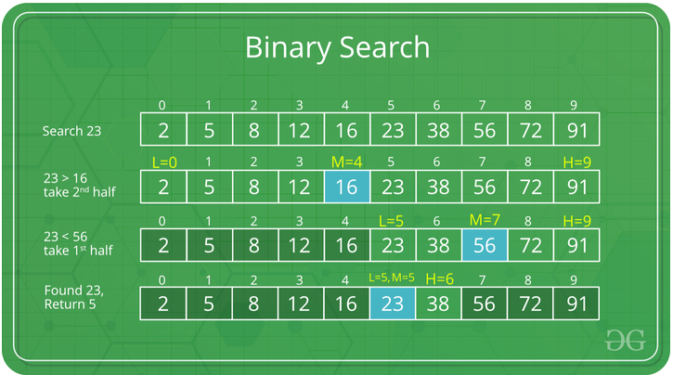
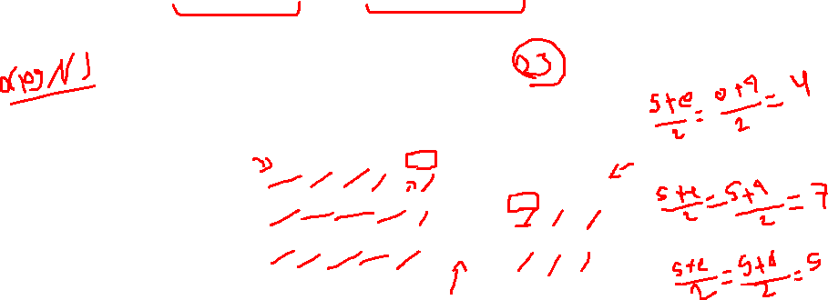
Binary search
Given a sorted array and a target element , search in the array on the target element.
https://www.geeksforgeeks.org/binary-search/

Slide 12
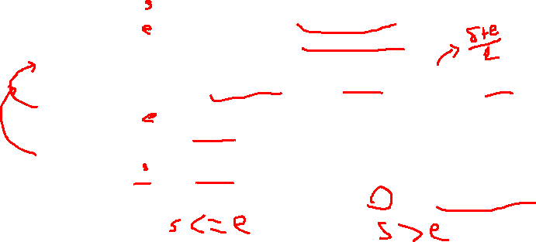
Binary search -cont
Pseudo code
Initialize low to index of the first element.
Initialize high to index of the last element.
Initialize mid to average of the low and high.
If the element at mid index is the target return the mid.
Else If the element at mid index is greater than the targe. change high to mid-1 and repeat from step3.
Else If the element at mid index is smaller than the target. change low to mid+1 and repeat from step3.
If the low is greater than high return -1 as it is not found.

Slide 13
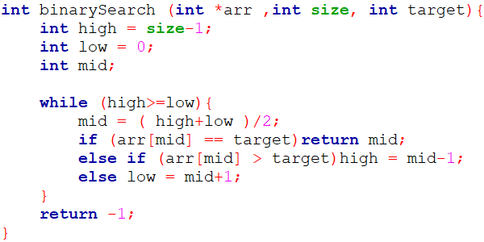
Binary search code
https://ideone.com/8nyPM2
https://ideone.com/7wMkYZ

Slide 14
Binary search analysis
L
M
H
Target is 16
Size of searching area is n at iteration 1
Size of searching area is n/2 at iteration 2
Size of searching area is (n/2)/2 = n/2² at iteration 3
3
6
7
9
10
16
18
20
30
78
L
M
H
3
6
7
9
10
16
18
20
30
78
M
L
H
3
6
7
9
10
16
18
20
30
78
reference-1
reference-2

Slide 15
Binary search analysis -cont
Suppose the number of iterations needed for the worst case is k when the searching area become one element.
n/2^{k} = 1
n = 2^{k}
Log₂ n = log₂ 2^{k}
Log₂ n = k log₂ 2
k = Log₂ n
iteration | size
0 | n
1 | n/2
2 | n/2²
3 | n/2³
: | :
k | n/2^{k}

Slide 16

Analysis of binary search
T(n) = log n
The best case is when the first element is the target.
Ω (n) = 1
The worst case is when the target element is the last element or when it is not found.
O(n) = log n
The average case is when the target element is the one in the middle.
ϴ (n) = logn/2

Slide 17
https://codeforces.com/contest/600/problem/B
https://ideone.com/nSUFL4
https://docs.google.com/document/d/1KofDX1tw9kyxTxaquvDtCcgDok5LEq4yqhmubDLHECI/edit#heading=h.4png286rn0oh

Slide 18
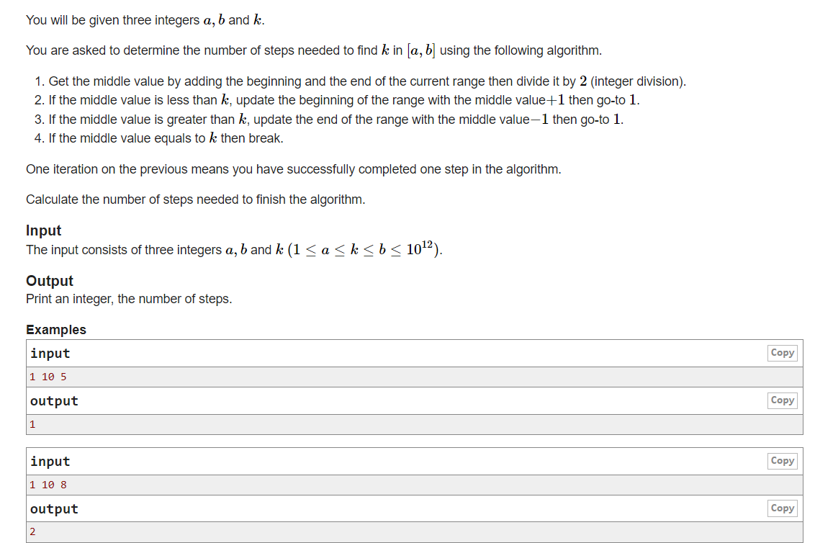
https://codeforces.com/group/rZXLOcYbKV/contest/313627/problem/A
https://ideone.com/y2VXAf

